Slide 1
INFO 656-01 Fall 2023 What is Machine Learning?
Week 1

Slide 2
Housekeeping
Amir Imani (He/Him)
Email: aimani@pratt.edu
Office Hours: Mondays (7pm-9pm).
Course website: https://github.com/Amirosimani/Machine_Learning_Pratt
Class discussion (30%)+ 4 Lab Assignments (20%)+ Final Project (10%+30%+10%)

Slide 3
Housekeeping
About the class
Read the required readings, submit 2 interesting points/your ideas/questions you’d like to discuss on Canvas
Class discussions
Lecture (combination of slides + code)
Guest lecturers

Slide 4

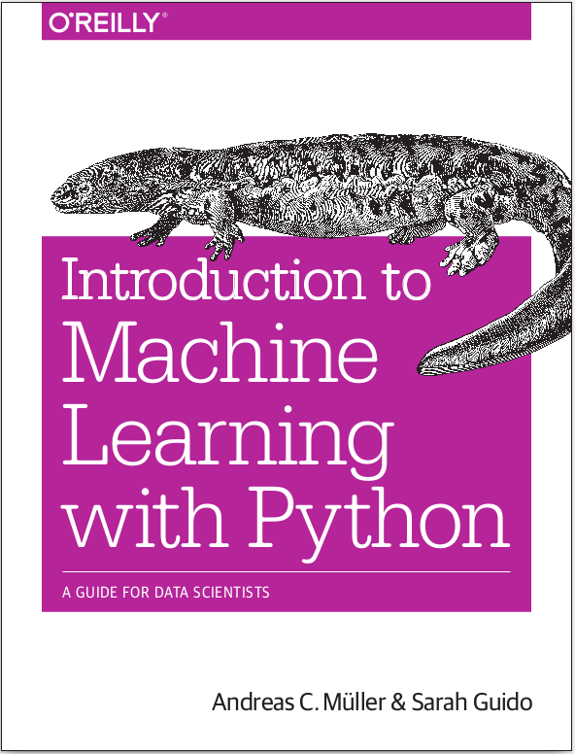


Books
http://ciml.info/

Slide 5
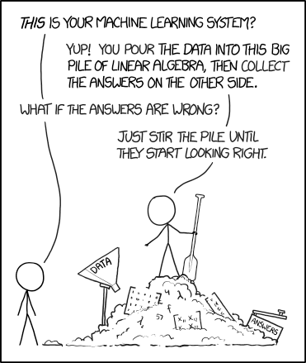
Machine Learning - What and Why
Source: Machine learning, XKCD

Slide 6
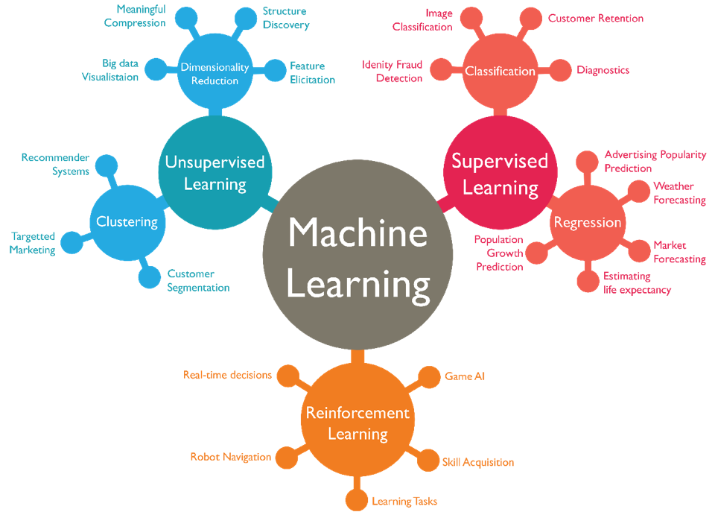
Types of Machine Learning
https://blogs.oracle.com/datascience/types-of-machine-learning-and-top-10-algorithms-everyone-should-know-v2

Slide 7
Other Machine Learning Considerations
Generative AI (week 11)
Data and the collection process (week 2)
Machine Learning vs Statistics (multiple weeks)
Machine Learning workflow (week 6, 11)
FATML (Fair Accountable Transparent ML) (Week 2, 12, 13)

Slide 8
Coding
Coding is not fun, It’s technically and ethically complex! ¹
1. https://aeon.co/ideas/coding-is-not-fun-it-s-technically-and-ethically-complex
Notes:
Regardless of why you are using ML for, you need to code!
What is code? Refer to Bloomberg article
What is algorithm?
Coding is hard - needs focus, attention, logical problem solving, requires a state of mind called being ‘in the flow’, a quasi-symbiotic relationship between human and machine that improves performance and motivation.
Coding isn’t the only job like that, but media/ent, policymakers and technologists pretend otherwise
Ethically complex: More and more ‘decisions’ are being entrusted to software, including life-or-death ones: think self-driving cars; think semi-autonomous weapons. we can’t respond to them by answering exclusively technical questions.
the machine does what you say, not what you mean. Programming is not a detail that can be left to ‘technicians’ under the false pretence that their choices will be ‘scientifically neutral’

Slide 9
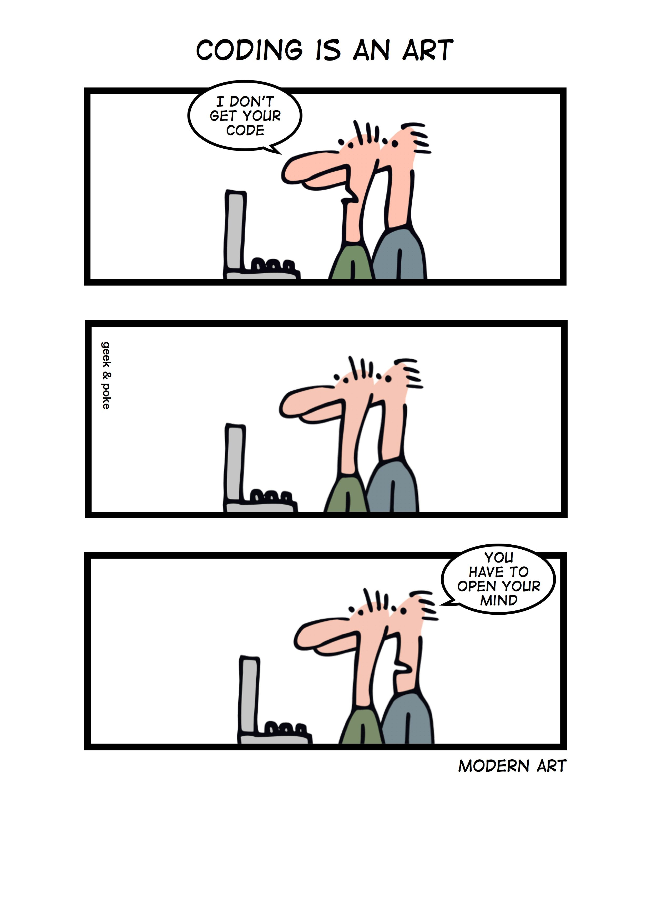
Coding
“Programs must be written for people to read, and only incidentally for machines to execute. ” — Harold Abelson
“Any fool can write code that a computer can understand. Good programmers write code that humans can understand.” — Martin Fowler

Slide 10
General Coding Guidelines
Don’t be clever!
Follow conventions.
Make it readable. Your future self is the most likely the one who needs to understand it!

Slide 11
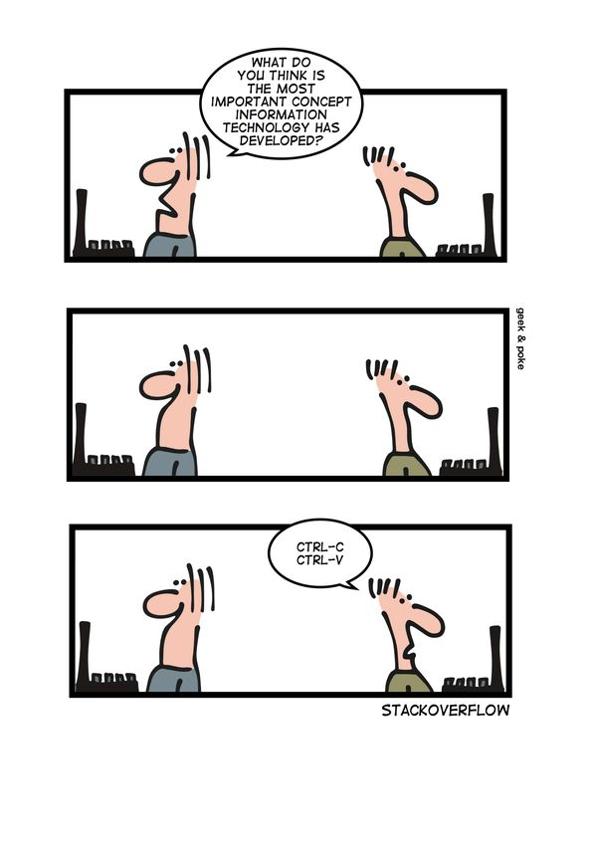
General Coding Guidelines
Don’t be clever!
Follow conventions.
Make it readable.
Avoid writing code.

Slide 12
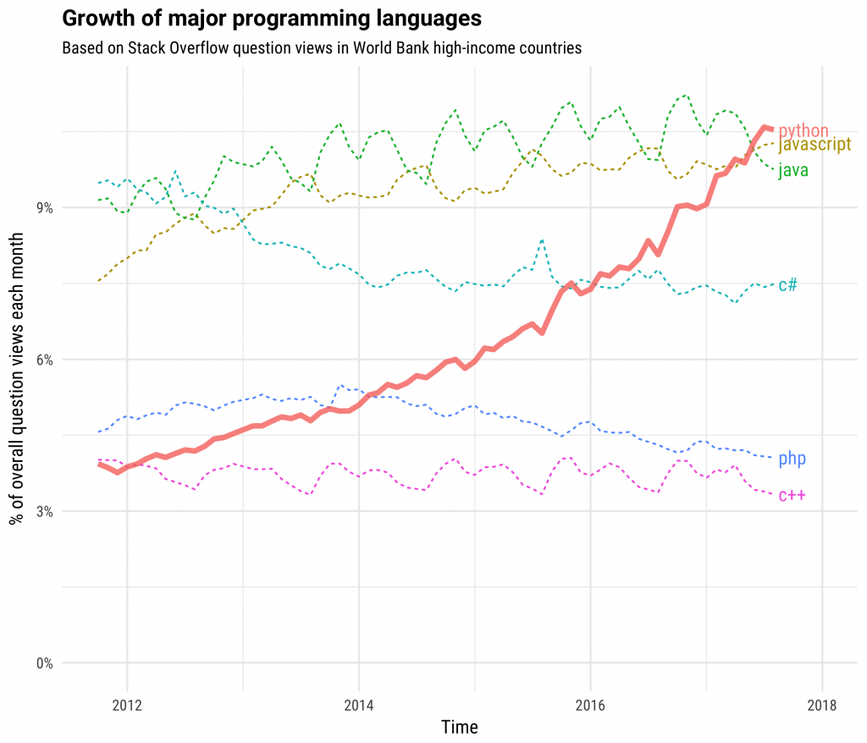
Why Python?
High-level and Interpreted
General-purpose
Multi-paradigm (OOP & Functional)
Modular
Interactive
Dynamic
Great Libraries
Easy to use
https://stackoverflow.blog/2017/09/06/incredible-growth-python/

Slide 13
Code as an Artifact - Python Good Practices
Use Python 3.x
Always create/use “virtual environments”
Lint your code (PEP8)
Add comments
Learn about “modular coding”

Slide 14
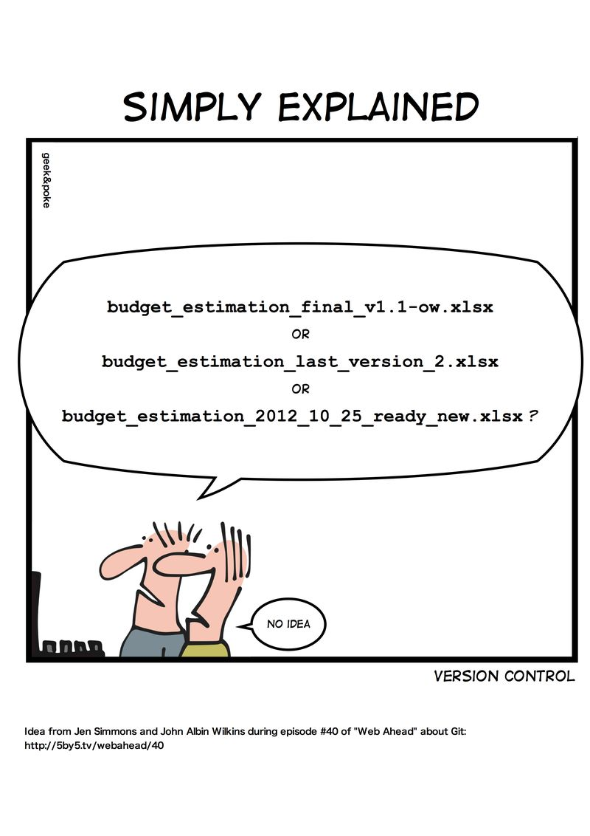
Version Control

Slide 15
Questions?

